Slide 1

MAVEN

Slide 2
What is Maven
Maven is a project management and comprehension tool that provides developers a complete build lifecycle framework.
History of maven :
Maven, a Yiddish word meaning accumulator of knowledge.
Firstly it used in Jakarta Turbine project.
As an attempt to simplify the build processes.

Slide 3
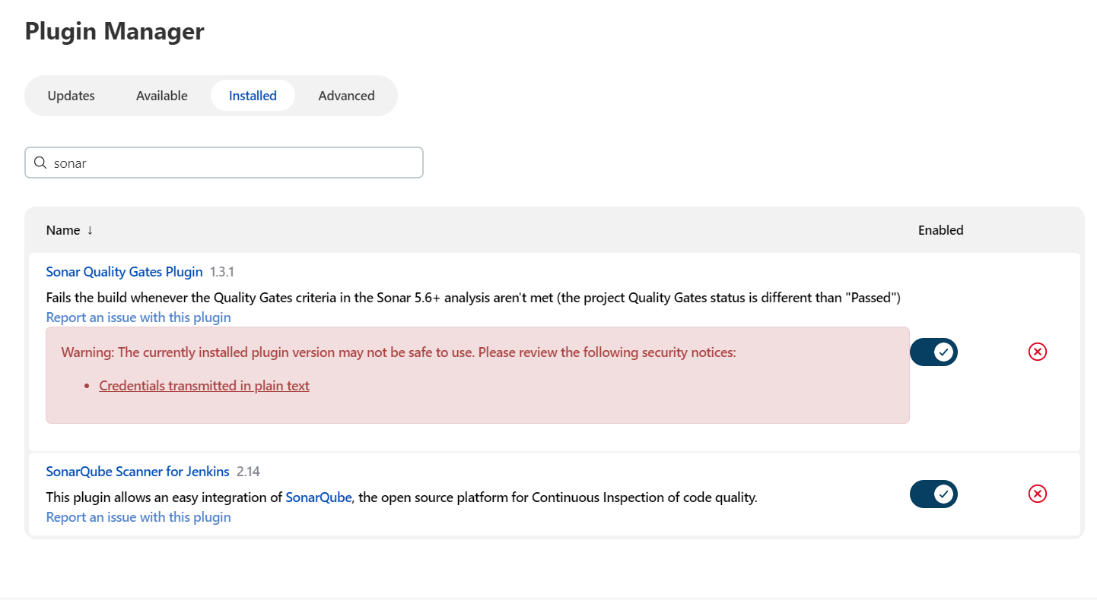
Install the following plugins for integrating with sonarqube
Sonar quality gates plugin.
Sonarqube scanner for Jenkins.

Slide 4
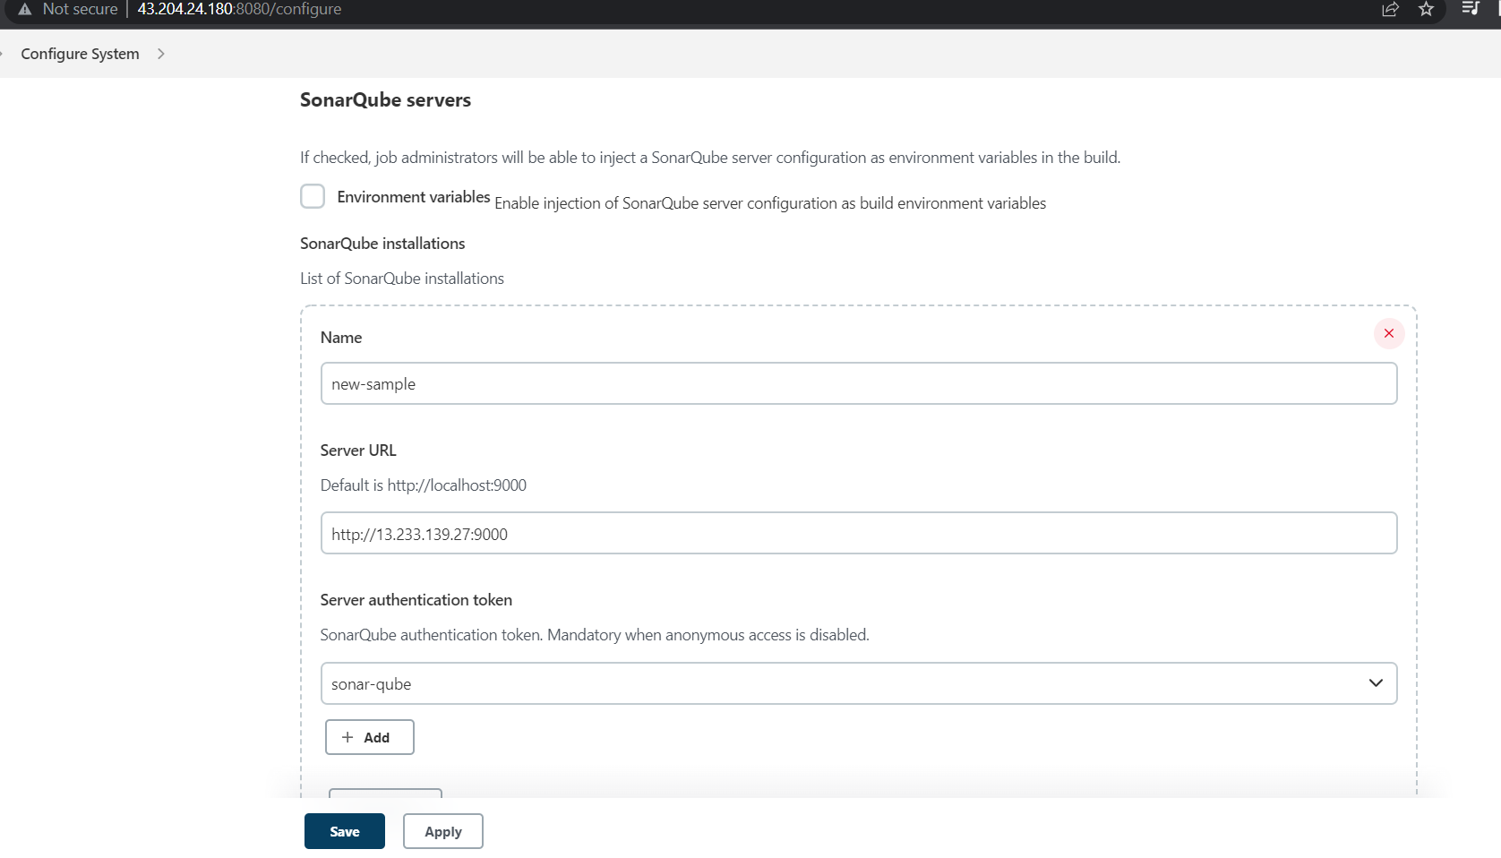
Open the configure system & provide the IP & server authentication token.

Slide 5
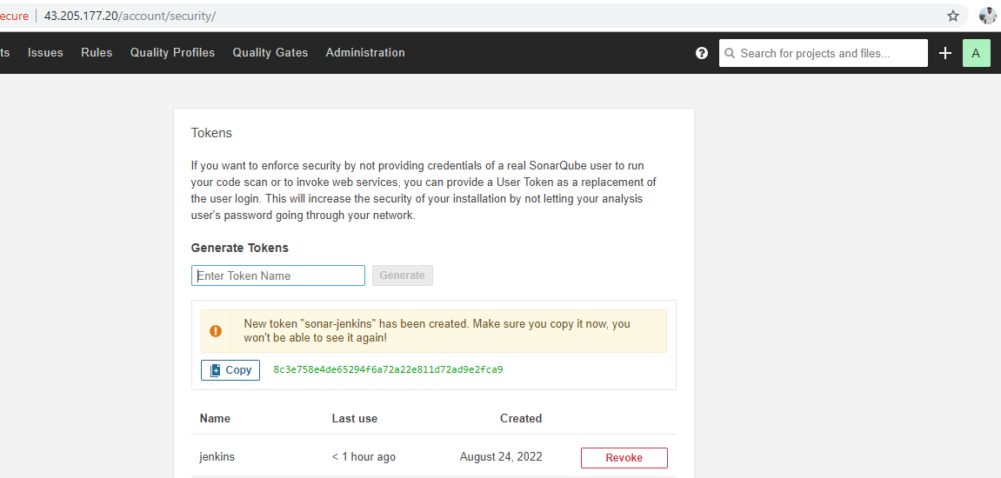
Click on administrator & click on security

Slide 6
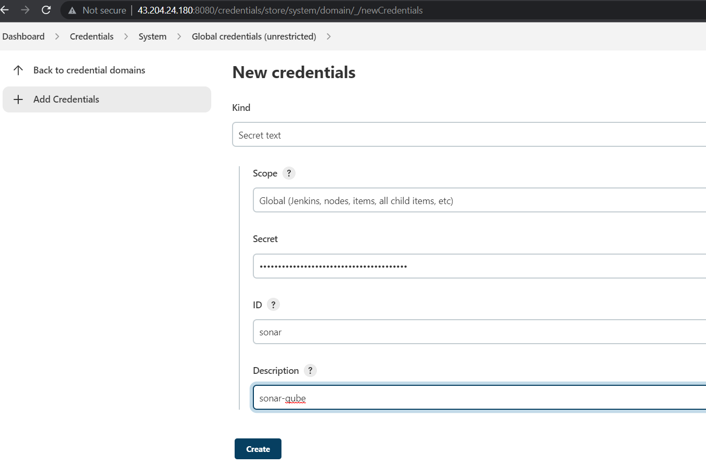
open the credentials & click on system, global credentials
Add the
sonarqube token.

Slide 7
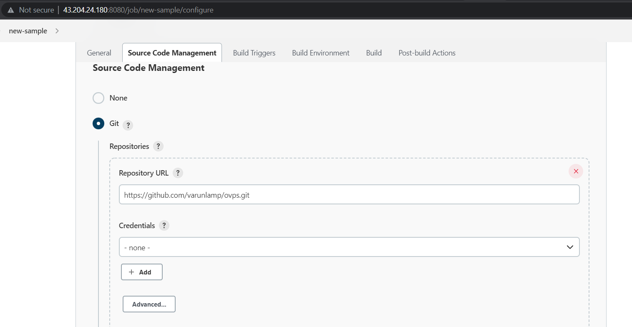
Provide the github repository url which consist of code.

Slide 8
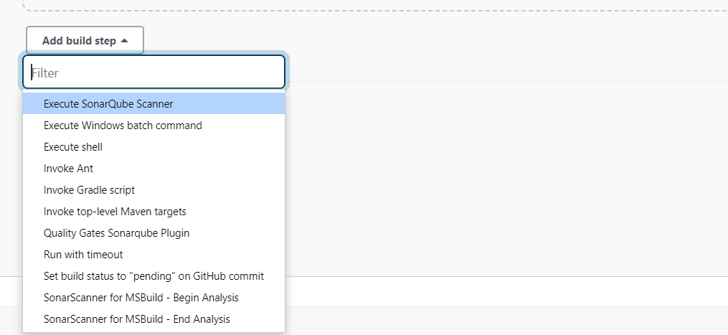
Click on add build step & select the
Execute sonarqube scanner.

Slide 9
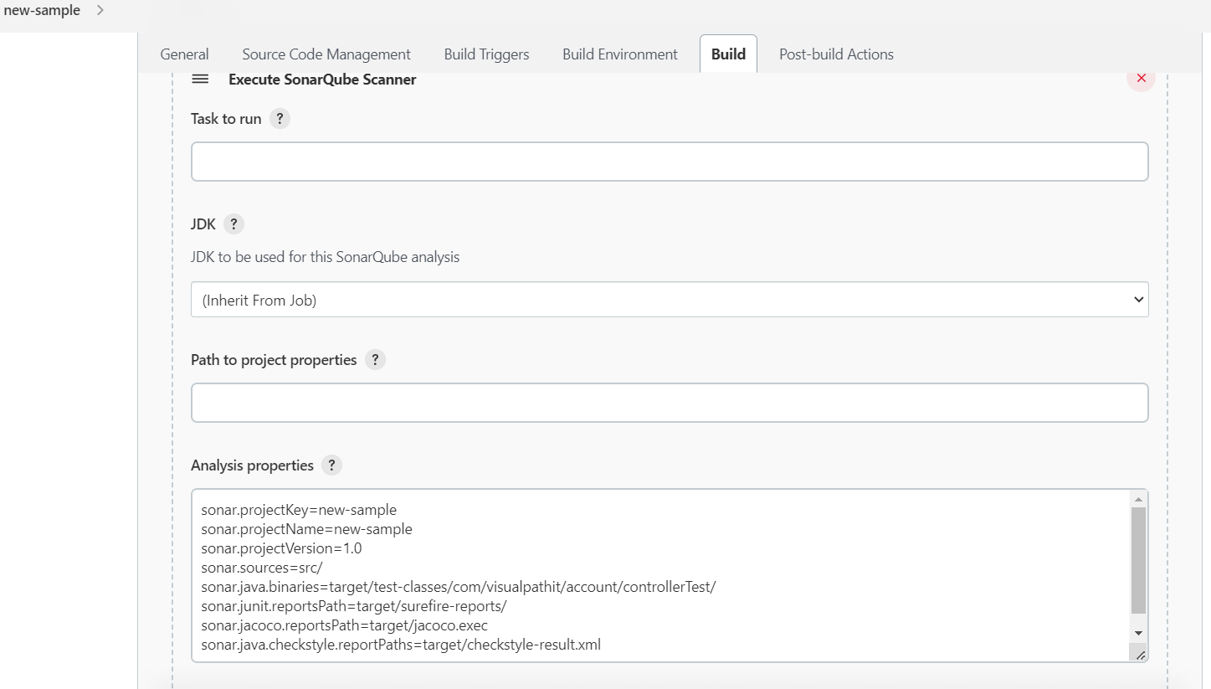
Add the properties which and all properties should be check in analysis properties.

Slide 10
Properties which need to be check in analysis properties.
sonar.projectKey=new-sample
sonar.projectName=new-sample
sonar.projectVersion=1.0
sonar.sources=src/

Slide 11
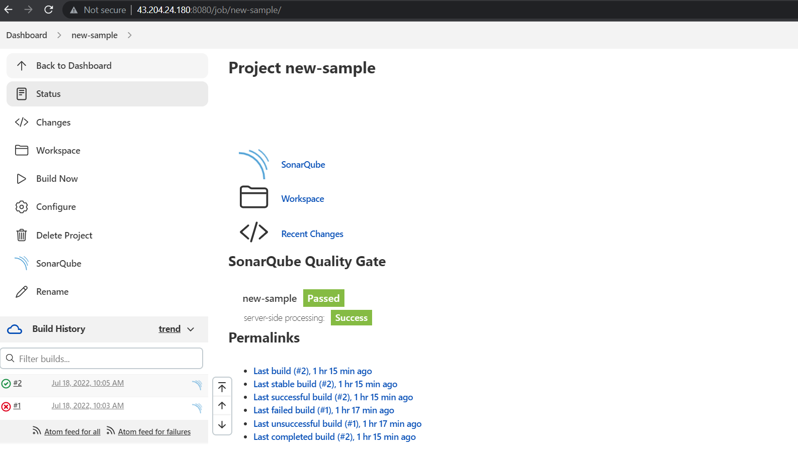
When we click on project it will display the report of bugs .

Slide 12
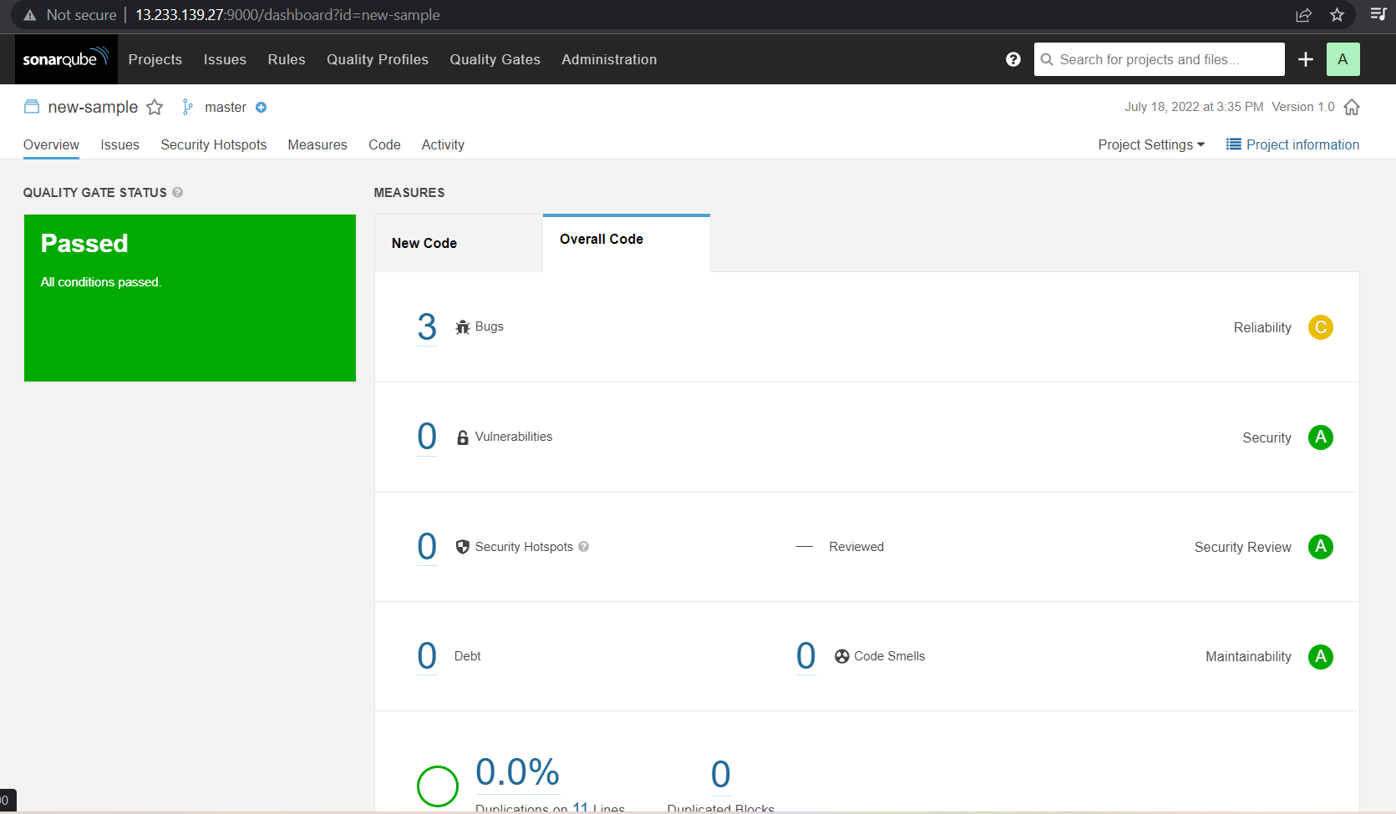
Generated report.

Slide 13
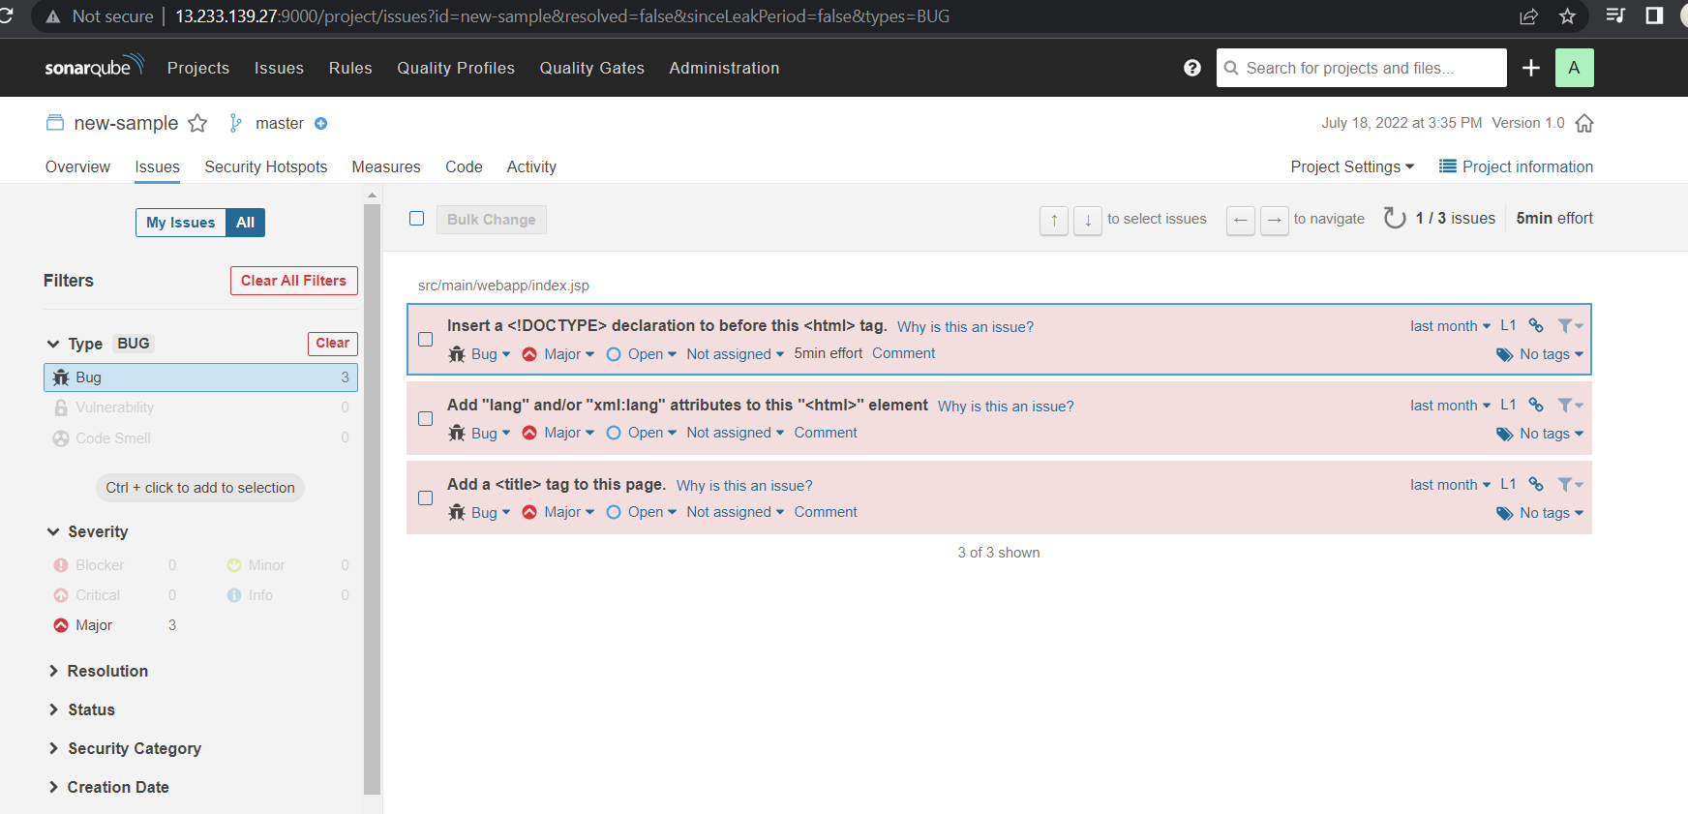
Bugs report/ it will display the errors & which needs to fix.

